Slide 1
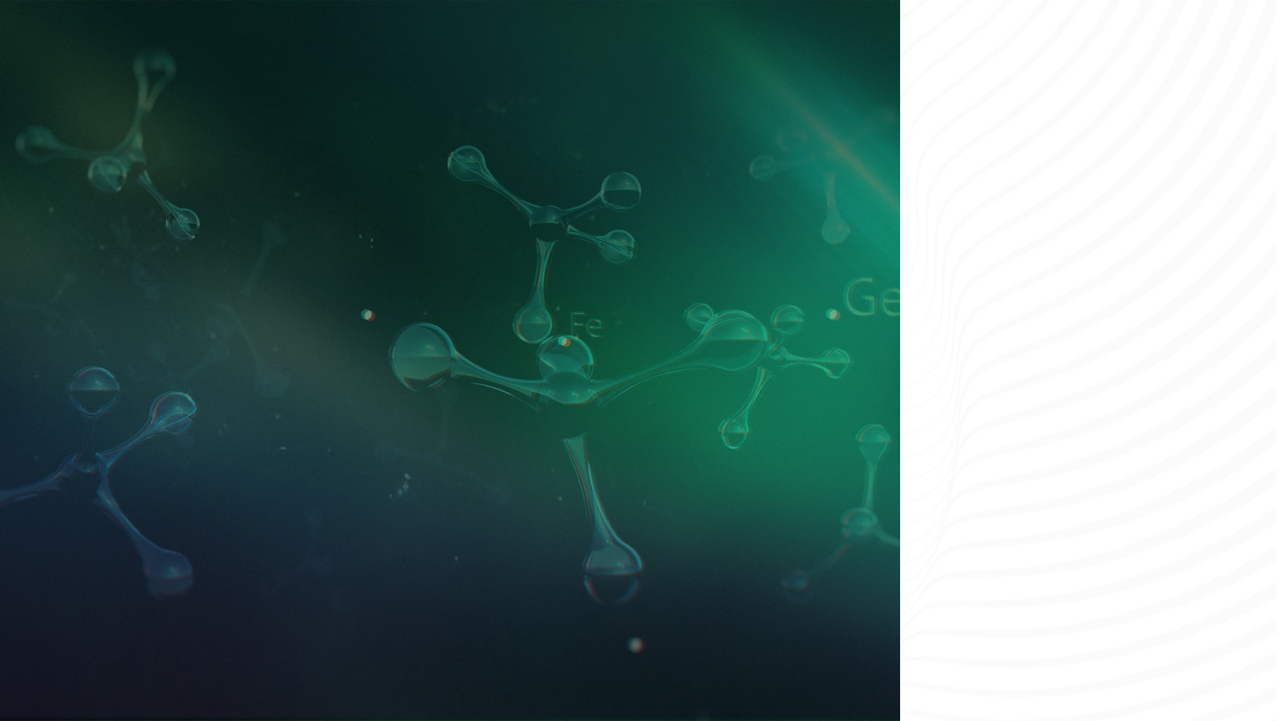

ScNET A Model That Combines PPI and Gene Expression
© ThinkBio.Ai All Right Reserved

Slide 2
Agenda
Single Cell Data Challenges And Solutions
ScNET –Overview And Architecture
ScNET Results

Slide 3
Single Cell Analysis And PPI Solutions
 | CD3D | CD4 | CD8A | MS4A1 | LYZ
Cell_1 | 5 | 8 | 0 | 0 | 5
Cell_2 | 6 | 0 | 10 | 0 | 9
Cell_3 | 0 | 0 | 0 | 12 | 0
Cell_4 | 2 | 0 | 1 | 0 | 37
1.1 What's Single Cell data
  adata.x raw biological measurement.
  adata.obs helps us interpret and label cells.
  adata.var helps us select and interpret genes.
cell_id | cell_type | n_genes | n_counts
Cell_1 | CD4 T cell | 3 | 18
Cell_2 | CD8 T cell | 4 | 25
Cell_3 | B cell | 2 | 12
Cell_4 | Monocyte | 5 | 40
gene_id | gene_name | highly_variable
G1 | CD3D | True
G2 | CD4 | True
G3 | CD8A | True
G4 | MS4A1 | True
G5 | LYZ | True

Slide 4
1.2. Challenges in the single cell data​
Gene / Cell | Cell_1 | Cell_2 | Cell_3 | Cell_4 | Cell_5 | Cell_6
Gene_A | 0 | 3 | 0 | 0 | 1 | 0
Gene_B | 0 | 0 | 0 | 2 | 0 | 0
Gene_C | 5 | 0 | 4 | 0 | 0 | 6
Gene_D | 0 | 0 | 0 | 0 | 0 | 1
Gene_E | 2 | 0 | 0 | 1 | 0 | 0
60–95% of the matrix entries can be zero – zero inflation.
Two sources – Biological zeros (aka Real Signal )and Technical Zeros(Dropouts)
Zero inflation nature
Complexes and
pathway activation
struggles to delineate

Slide 5
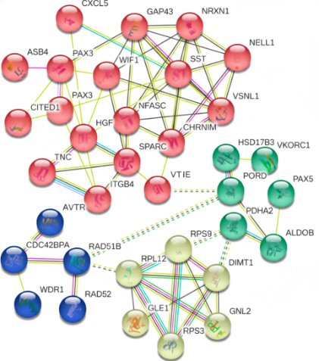
1.3 .Existing techniques to resolve Zero Inflation
ScRNA-seq
data imputation
Methods focus on the
numerical recovery
Correlation based
PPI network Based
zero inflated probabilistic models
nearest neighbour-based smoothening
dense latent representations
considers sequence depth and read errors
Pathway activation - Protein Complex activation - Signal Transduction.
Construction at global scale.
contextual information from PPI + Strong functional annotation from ScRNA-seq
Studies in PPI integration
  PPI-based propagation
  NSCLC survival models
  scRNA-seq enhancement.
  ScLINE
  PINNACLE
  scNET

Slide 6
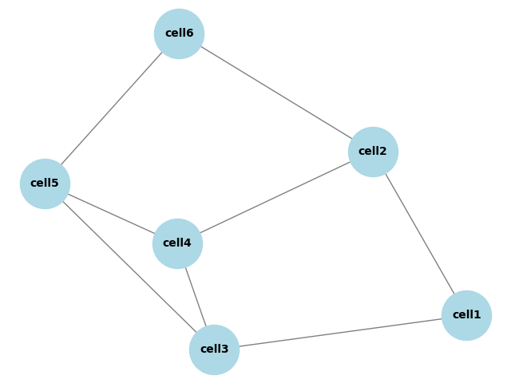
ScNET –Overview And Architecture
scNET
adata
scNET
Reconstructed adata

Slide 7
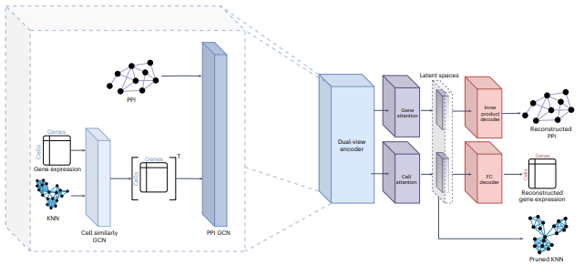

Slide 8

ScNET Results
  Gene Embeddings Improve Functional Annotations
  Co-embedded Network And Pathways
  Cell Clustering Evaluation
  Reducing Zero Inflation And Improving Pathway Analysis

Slide 9

Thank You
3020 Old Ranch Pkwy.
Suite 300, Seal Beach, CA 90740
3602 Inland Empire Blvd., Suite C200,
Ontario, CA 91764, United States
611 Gateway Blvd, Suite 120,
South San Francisco, CA 94080
Info Park Phase-II,
Kakkanad, Kochi, India
Yamuna, Technopark Phase III
Trivandrum, India
34-35 Hatton Garden, Holborn,
London EC1N 8DX
contactus@thinkbio.ai
+1- 909-303-3338

